Slide 1
Accessibility Standards Canada
Annual Public Meeting
May 31, 2021

Slide 2
Get to know us!
Created in 2019 under the Accessible Canada Act
“Nothing without us” is at the heart of our mandate
We fund research and develop standards to make Canada more accessible.

Slide 3
Governance
Philip Rizcallah, CEO, is in charge to oversee day-to-day operations
Managed by a Board of Directors
Majority-led by people with disabilities

Slide 4
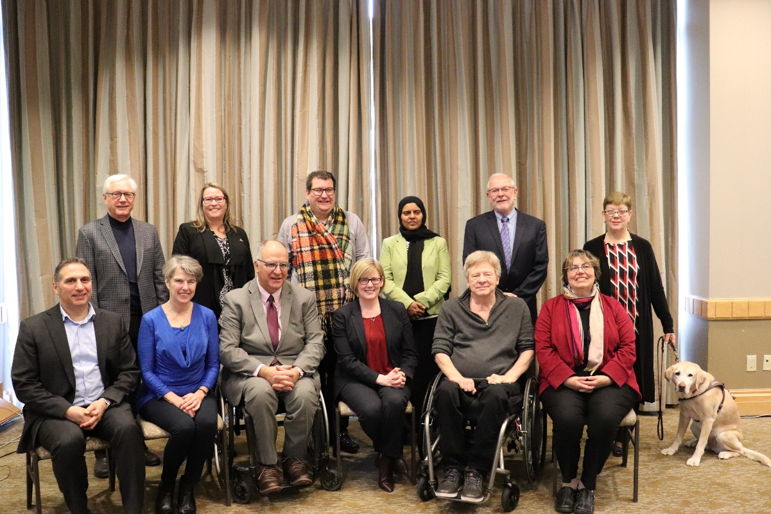
Board of Directors
Paul-Claude Bérubé, Chairperson
Mary Reid, Vice-Chairperson
William Adair
Kory L. Earle
Maureen Haan
Penny Hartin
Rabia S. Khedr
Brad McCannell
Dr. Joe McLaughlin
Laurie Ringaert

Slide 5
Mandate
Develop and review accessibility standards for organizations under federal jurisdiction
Support research on the identification, removal and prevention of barriers
Share best practices about the removal of barriers.

Slide 6
Priority areas

Slide 7
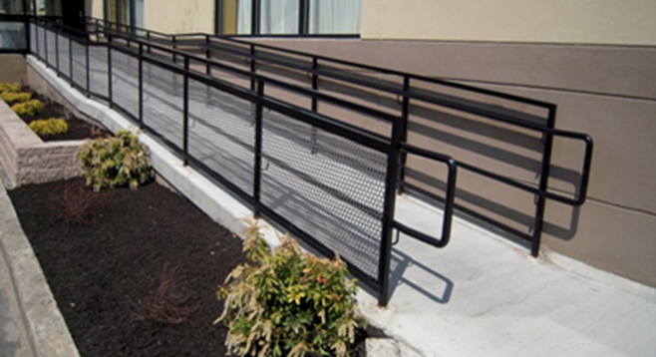
1. Built environment

Slide 8
2. The buying of goods, services and facilities
Notes:
Public sector organizations will need to include accessibility criteria in their processes for buying and acquiring goods, services and facilities. / Les organisations du secteur public devront intégrer des critères d’accessibilité à leurs processus d’achat et d’acquisition de biens, de services et d’installations

Slide 9
3. Employment
Notes:
Be inclusive and increase labour-force participation and purchasing power amongst persons with disabilities. Recruitment, retention, emergency response, accommodation, performance management and career development practices. / Être inclusif et accroître la participation des personnes en situation de handicap sur le marché du travail, ainsi que leur pouvoir d’achat. Adopter de saines pratiques en matière d’embauche, de maintien en poste, d’intervention d’urgence, de mesure d’adaptation, de gestion du rendement, et du cheminement de carrière.

Slide 10
4. Communications (not including ICT)
Notes:
Providing clear and concise information, targeted to a particular audience, is important to ensure that all users have equal access to information. Although the vehicle for this information may change, the message is the same. / Transmettre des renseignements clairs, concis et ciblés pour que tous les utilisateurs aient un accès égal à l’information. Le mode de communication peut varier, mais le message doit demeurer le même.

Slide 11
5. Design and delivery of programs and services
Notes:
Re-design programs and services to remove systemic barriers.
Appropriate training of staff.
Repenser les programmes et les services de manière à éliminer les obstacles systémiques.
Offrir au personnel la bonne formation.

Slide 12
6. Transportation

Slide 13
7. Information and communication technology

Slide 14
Where we are now?

Slide 15
Funding research [1 of 2]
The research we fund will help inform the development of standards.
To date, we have funded 24 projects on:
Employment
Built environment
Accessible communications
Information and communication technologies
Emergency measures
Accessibility in Indigenous communities

Slide 16
Funding research [2 of 2]
Examples of projects include:
Identifying barriers to accessibility in national parks
Environmental scan on accessibility standards in Indigenous communities
Study of evacuation guidelines for persons with disabilities in urban centres during emergencies

Slide 17
Creating Standards [1 of 2]
Technical committees creating standards for:
Built environment
Emergency egress
Outdoor spaces
Plain language
Employment

Slide 18
Creating Standards [2 of 2]
Ongoing work with the CSA Group on standards for:
Accessible electronic payment terminals
Accessible design for the built environment
Accessible housing (with the Canada Mortgage and Housing Corporation)

Slide 19
Guidelines related to COVID-19
Accessibility guidelines on emergency situations:
Return to work and work from home
Communications
Service Delivery
Inclusive emergency responses
Created in collaboration with stakeholders
Notes:
Red indicates new text that must be translated

Slide 20
Consulting Canadians

Slide 21
First consultations with Canadians
Closed our first public consultation on September 30, with almost 600 responses.
Consultation report available on accessible.canada.ca

Slide 22
Overview of consultations
We asked:
How we should continue to engage Canadians with disabilities
Where we should focus our research and standards
65% of participants were persons with disabilities

Slide 23
Key findings for engagement
A flexible and accessible approach is key
81% participants preferred group discussions

Slide 24
Research priorities
Top priorities:
Employment
Built environment
Design and delivery of programs and services
Participants often raised the importance of intersectionality
Involving persons with disabilities is important to research

Slide 25
Priorities for standards
Top priorities:
Employment
Built environment
All priority areas are interconnected
Involving persons with disabilities is important for standards development

Slide 26
“Nothing without us”
The results of our consultations inform our standard development and research priorities
We always want to hear from Canadians, and we will continue to work with you towards an accessible Canada

Slide 27
Where we are going: 2021-2022

Slide 28
Research priorities
Accessibility in Indigenous communities
Built environment, with a focus on heritage buildings
Communication, other than plain language
Design and delivery of programs and services
Information and communication technology
Procurement (buying) of goods, services and facilities

Slide 29
Priorities for standards [1 of 2]
We will set up technical committees to develop standards on:
Acoustics
Wayfinding (including signage)
Emergency measures (particularly during a pandemic)
Procurement (the buying of goods, services and facilities)

Slide 30
Priorities for standards [2 of 2]
We will seek accreditation as a standards development organization.
We will work with provinces and territories.
We will continue working with other organizations to develop standards.

Slide 31
Conclusion
We have a lot of work ahead of us.
We are excited to keep moving forward with you towards an accessible Canada!

Slide 32
Thank you!

Slide 33
Questions?
Click on “Participate”
Or send us an email:
ASC-NAC@canada.gc.ca

