Slide 1
Accessibility Standards Canada’s Annual Public Meeting May 22, 2024 Leading change to make Canada accessible and include all people.

Slide 2
To Access American Sign Language Interpretation
Click on “Sign language”

Slide 3
To See Captions

Slide 4
Technical Issues?
Click on “Help”
Send an email to: helpdesk@collaboratevideo.net

Slide 5
Slow Connection?
Try turning off the video:
1. Click on “Settings”
2. Choose “Audio Only”

Slide 6
Land Acknowledgement
We pay respect to the Algonquin people, the traditional guardians of this land. We acknowledge their longstanding relationship with this territory, which remains unceded. We pay respect to all Indigenous people in this region, from all nations across Canada, who call the National Capital Region home. We acknowledge the traditional knowledge keepers, both young and old. And we honour their courageous leaders: past, present, and future. We encourage you to learn about the Indigenous peoples and lands in your local area.

Slide 7
Our Work - Key Achievements
Funded 32 new research projects
Consulted the public on 3 draft standards
Since 2022, ASC has attended more than 100 stakeholder meetings, events and conferences
Created 3 new technical committees
Signed 6 Memoranda of Understandings
Named a top employer in the National Capital Region (NCR)

Slide 8
Our Work - Key Plans
Advancing 18 standards currently at different stages of development
Publishing our first 2 finalized standards
Launching a call for proposals for the 2025-2026 funding cycle
Creating 2 new technical committees: tourism and procurement processes
2 more standards undergoing public review

Slide 9
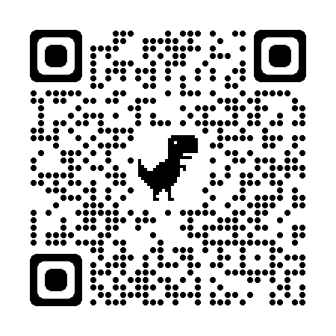
Centre of Expertise
18 standards in development and published
86 research projects, representing over $43 million in funding
All standards and research are free of charge
accessible.canada.ca/centre-expertise

Slide 10
How to Get Involved
Participate in the standards development process:
Apply to be a member of a technical committee
Send us your comments and feedback about draft standards
Apply and/or participate in a research project
Submit your name for appointment to the Board of Directors
Visit our Centre of Expertise
Subscribe to our newsletter
Follow us on social media: X, Facebook, and LinkedIn
Register for our Annual Public Meeting

Slide 11
Question 1
What is being done to ensure Canadians experience the same accessibility wherever they live, work and play?

Slide 12
Question 2
How will Accessibility Standards Canada’s standards fit in the hierarchy of the National Building Code and CSA Group standards?

Slide 13
Question 3
Is Accessibility Standards Canada doing anything to help advance accessibility of housing in the National Building Code?

Slide 14
Question 4
Will best practices for handling the recruitment process be covered in the employment standard. Specifically, how to handle virtual interviews. Also, how will the standard address reasonable accommodations. Are we moving away from reasonable accommodations to an employee-led and empowered model. What is your advice for organizations looking to change their culture and practice?

Slide 15
Question 5
How will invisible disabilities be incorporated in your work? This includes cognitive disabilities as well as and chronic and episodic health disabilities.

Slide 16
We Want to Hear from You!
Call or email us:
1-833-854-7628
ASC-NAC@canada.gc.ca

Slide 17
Thank you!

